Slide 1
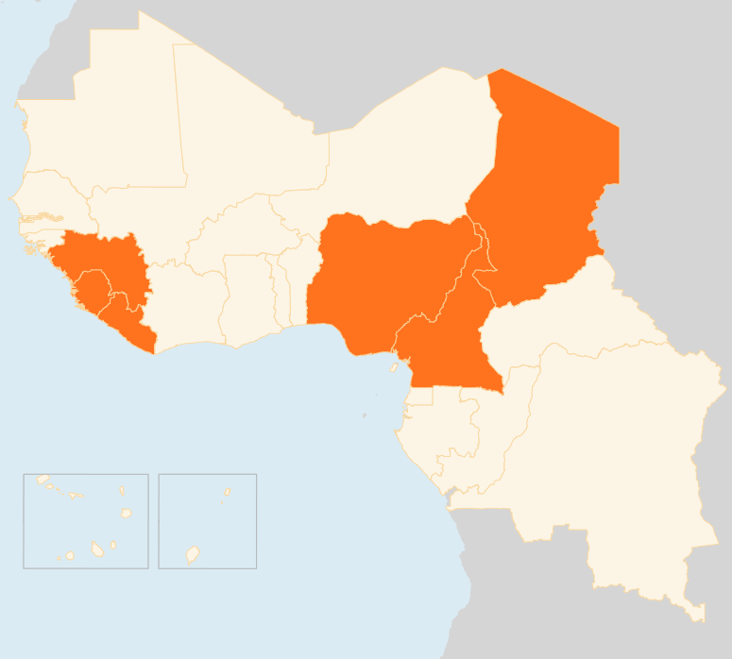


21 – 27 July 2015
CAMEROON
33 KILLED IN SUICIDE BLASTS
On 25 July, 20 people were killed when a suicide attacker struck a bar in Maroua town, the capital of the Far North Region. The attack, the most deadly of its kind so far, was the third in the region in two weeks. Cameroon’s Far North Region has been repeatedly targeted by Boko Haram insurgents. No gap in terms of medication and medical material is reported so far, but MSF estimates that in case other attacks occur, capacity of health centres will be overwhelmed.
CHAD
7,000 NEW INTERNALLY DISPLACED REPORTED IN LAKE REGION
Over the last week, large spontaneous displacements have been observed in the Lake region due to fear of Boko Haram. An estimated new 7,000 IDPs have been reported. The IDPs are extremely vulnerable as they sleep in the open in the current rainy season in a cholera-endemic area. Humanitarian partners on the ground are working to develop response actions for shelter, WASH and health. An OCHA-led mission including UNICEF and Chadian refugee authorities (CNARR) met on July 27 with the local authorities to undertake a preliminary needs assessment between Bol and Baga Sola.
MEASLES CASES CONTINUE TO RISE IN EASTERN CHAD
Between 1 - 15 July, some 122 cases of measles, including two deaths were reported in the eastern Abeche region compared to 189 cases and three deaths in the whole of June. On 21 July, a response plan targeting over 62,000 children in Abeche was launched by partners (Delegation of the Ministry of Health, UNICEF, WHO, MSF-Hollande and PU-AMI). By the end of July, all children between six months and 14 years will be vaccinated. The outbreak is likely due to the return of gold miners from neighbouring Sudan, which is battling to contain its worst measles outbreak in recent years.
NIGERIA
BOKO HARAM SEIZES TERRITORY
Boko Haram has been gaining strength recently in parts of the northeast and has captured five Local Government Areas in Yobe and Borno States, according to media sources. Regular attacks by the insurgents continued in the northeast this week, including three explosions suspected to be IEDs in Gombe on 23 July, killing 40 people.
INFLUX OF NIGERIAN RETURNEES
A steady flow of Nigerian returnees has been reported crossing the volatile border between Cameroon and Nigeria into the Mubi Local Government Area of Adamawa State in the northeast. Government sources in Adamawa reported that as of 23 July they had received 154 returnees into Malkohi camp near the state capital Yola. They are expecting a further 340 returnees following recent suicide attacks in Chad.
EVD REGIONAL
COUNTDOWN TO EBOLA-FREE LIBERIA STARTS
Liberia’s countdown towards being declared Ebola-free again started on 24 July, a day after the last confirmed patient was discharged. Training on EVD surveillance and dead body management is ongoing in counties with WHO support. On 21 July in Guinea, an EVD case detection campaign started in Matam and Ratoma areas of Conakry prefecture. In Sierra Leone, two EVD cases in Western Urban Area, one of the hotspot districts for the virus, have raised concerns about shortcomings in contact tracing and medical follow-up.
CHAD
7k
NEW IDPs IN LAKE REGION
NIGERIA
BOKO HARAM SEIZES TERRITORY
CAMEROON
33
EVD REGIONAL
KILLED IN SUICIDE BLASTS
COUNTDOWN TO EBOLA-FREE LIBERIA
Creation date: 28 July 2015
Map data sources: UNCS, DevInfo, OCHA.
The boundaries and names shown and the designations used on this map do not imply official endorsement or acceptance by the United Nations

